Slide 1
Cybersecurity Essentials
for 2021
Ron Benvenisti
November 16, 2020

Slide 2
Know Your Security Ecosystem Overview
Cyber & Information Security Ecosystem
Business Focus Areas
Assessment Process
Verticals
Cloud
Mobility
Social Media
Analytics
Assess
Risk Posture
Protect Information & Assets
Control Risks
Defend Against Threats
Monitor Environment
Healthcare
Banking & Financial Services
Retail, Telecom & Media
Public Sector
Security Practice Group Offerings
Governance, Risk and Compliance (GRC) Services
Identity and Access Management (I&AM) Services
Threat and Vulnerability Management (T&VM) Services
Ron Benvenisti

Slide 3
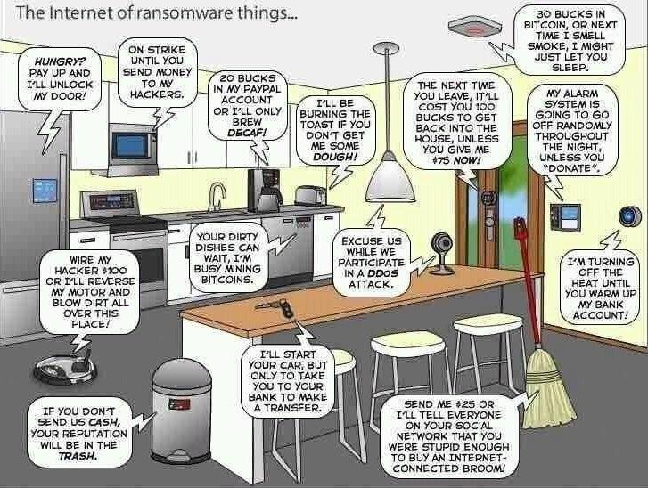
Plus,You've Got a lOT of New Friends
Ron Benvenisti

Slide 4
Have Agile Delivery & Transformation
Project management, communication management and change management support for strategic digitization programs
Cost and savings strategies throughout External Resourcing environment and SW negotiation for cloud services, software, hardware, telecom
Projects and resourcing for Packaged apps, BI, Cloud & Digital technologies
Technology based proprietary talent database and candidate assessment solution
Transparency of cost structure
We know how to build the best teams in an agile way
Cost Efficiency, Transparency, Process Transformation
IT Advisory & Projects
Threat & Vulnerability Management Services
Governance, Risk & Compliance Services
Identity & Access Management Services
Trusted advisory & business focused thought leadership
Defense-in-Depth oriented
Technology & Product Agnostic
Actionable Intelligence
Data analysis, segmentation and correlation to identify trends and root causes
Develop predictive models
Implementation and support of data warehouse, data analytics, visualization and modeling platforms
Master Data Management
Cyber & Information Security
Data Management
Indirect Tax & Global Trade
Discovery sessions for Improvement Analysis
Tax Engine & Global Trade Solution Selection
Global team of tax and trade digitization experts
End to end implementation support
Production support & upgrades
25+ Tax /Trade /ERP subject matter experts
Ron Benvenisti

Slide 5
Know Your Security Value Proposition
Business Driven
End-to-end Security strategy consulting via business posture assessment, followed by technology recommendations and remediation
Delivering direct & partner-led excellence in Security Awareness Training, Threat & Vulnerability Management, GRC & Identity & Access Management that provide comprehensive enablers to transform and evolve client business
Trusted Security Advisor
Understanding of client business & domain allows for the provision of secure and holistic solutions much more efficiently across disruptive technologies -Cloud, Mobility, Analytics & Social Media
Thought Leadership
across the data, network and application stacks. Security technology strengths in these domains provide effective strategic solutions to solve client business problems of today and tomorrow
Providing Actionable Intelligence through customized deliverables: reporting, targeted toward each and every stakeholder
Defense in Depth
A layered security approach that is pragmatic, and spells reliability, while keeping client TCO down
Technology/Product
Agnostic
To be the client’s ‘objective and unbiased’ security partner
Best-practices based approach resulting in process-driven consulting, delivering premium benefits for cloud, on-prem and migration from on-prem to cloud
Ron Benvenisti

Slide 6
Risk Management Comprehension
Product Engineering
Support all phases of Product Engineering Lifecycle
Solution & Integration
Making applications Identity-aware
Development of SSO provisioning and Federation connectors
Professional Services
End-to-end enterprise architecture planning
Enterprise IAM/Federation solutions
Federation solutions for SaaS/cloud apps
Security Awareness Training
Governance, Risk & Compliance (GRC)
Identity & Access Management (I&AM)
Threat & Vulnerability
Management (T&VM)
Risk, IT Security, Compliance & Privacy Regulatory Standards compliance
SOX 404, COBIT, PCI-DSS, ITIL V3, ISO
BCMS, HIPAA etc.
Specialized risk-based services
Assessment, remediation, baseline security
Data classification, baseline security
Information risk management
Technology , Network
Facility infrastructure security
Data Center Security Assessment
Vendor Risk Assessment
Third Party Assessments
IT Operational Risk Management
Privacy
Business Continuity and Disaster Recovery
Information Security Management Systems
Partner Reselling & Consulting
Web & Internet Application Security
Vulnerabilty Assessment & Pen Testing
Host/Network/Wireless Patch Management
Mobile
Cloud
Configuration
Infrastructure Design
VOIP/ SIP Testing
VPN Authentication & Encryption Services
2 Factor Authentication
Endpoint Protection
Code Review
Ron Benvenisti

Slide 7
From Risk Management to Cyber Compliance
Ron Benvenisti
Notes:
Plan of Action & Milestones
Risk Management Framework
Security Assessment Report
Assessment Officer
Security Control Assessment
Committee on National Security Systems Instruction

Slide 8
TVA vs. TVA
Conventional Threat & Vulnerability Analysis provides only reports or a dashboard where you must perform the data aggregation and configure them into custom reports to address C-level concerns and manually create runbooks for the technical staff.
Topological Visualization Analysis, which renders a total interactive visual view of your threat landscape in near real-time as a collapsible and expandable hierarchical level topology map of every element in a single easily configurable “glass pane” interface that is expandable or collapsible to any level of detail at will.
Even a junior level Security Analyst can identify assets at risk, prioritize the areas of concern and focus on attack vectors affecting critical assets at risk first, rather than trying to remediate the the entire ecosystem at once.
Ron Benvenisti

Slide 9
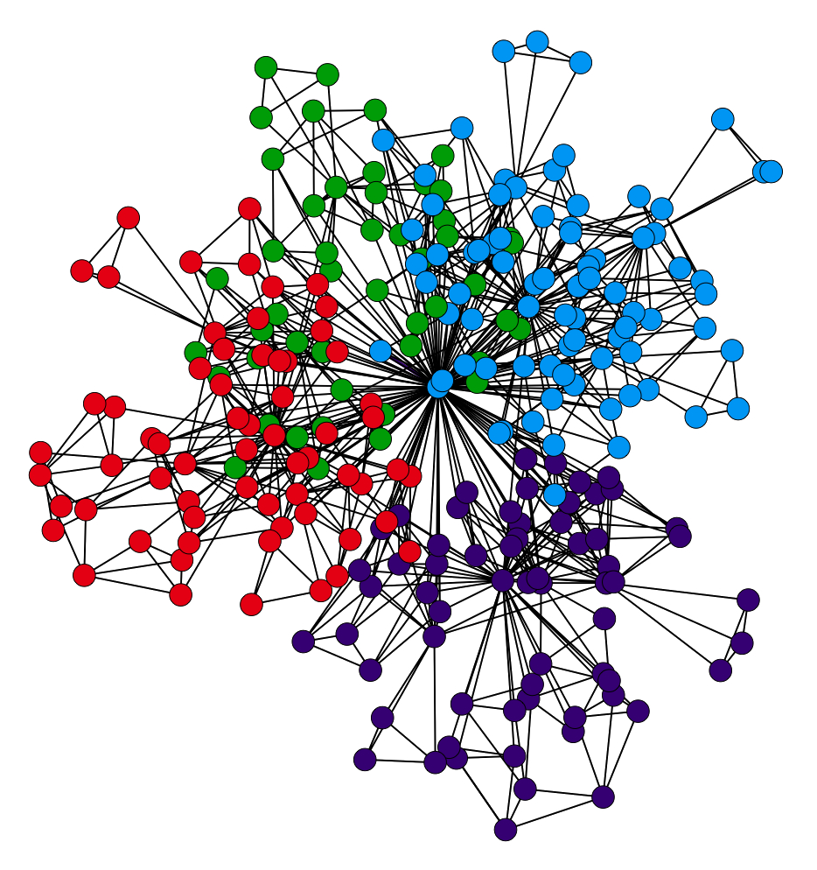
Artificial vs. Actionable Intelligence
Three Dimensional
Neural Network
Ron Benvenisti

Slide 10
Take Inventory of Your IT Assets
Ron Benvenisti

Slide 11
Map the Real Impact Vectors with TVA
Ron Benvenisti

Slide 12
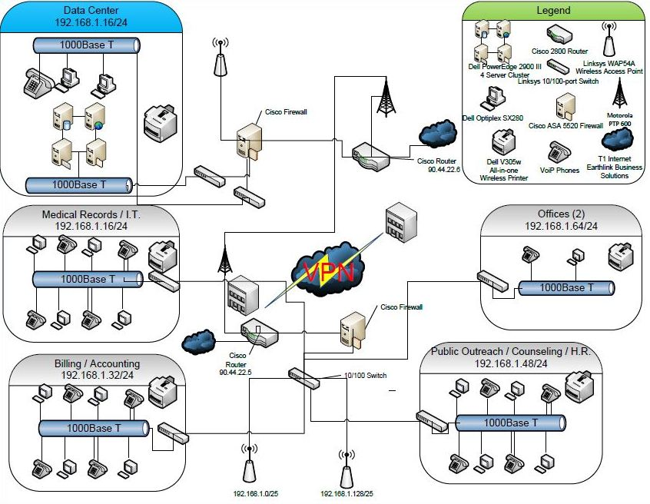
Know Your Topology
Ron Benvenisti

Slide 13
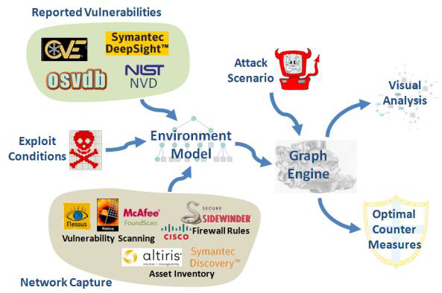
Common Operating Picture
Can you find the Vulnerability?
Visually Identify threats
Prioritize Mitigation
Strengthen Posture
Ron Benvenisti

Slide 14
Not a Common Operating Picture
Can you find the Vulnerability?
Visually Identify threats ?????
Prioritize Mitigation ?????
Strengthen Posture ?????
???!
2020 Dominion Election Topology
Courtesy of:
Allied Security Operations Group
ASOG
Ron Benvenisti

Slide 15
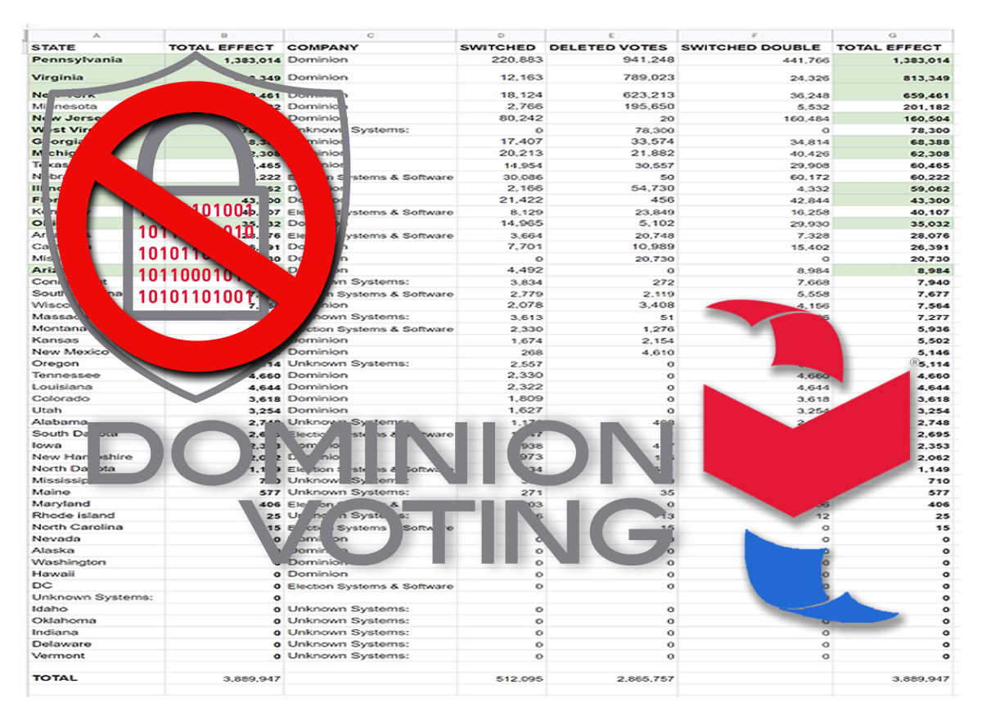
Totally Unsecured
Ron Benvenisti

Slide 16
No Nothing
The creation of the Help America Vote Act (HAVA) in 2002
under the Bush-2 Regime, removed from the American
people all semblance of honest and secure elections
in America.
The entire election process went cyber with no
standards of security or transparency installed to ensure
and guarantee election non-tampering.
All of our assumed 'secure’
election results are handled by private contractors outside of
the United States that we have ZERO control or oversight over.
This same system is in use in 2020 with zero cyber protections.
Ron Benvenisti

Slide 17
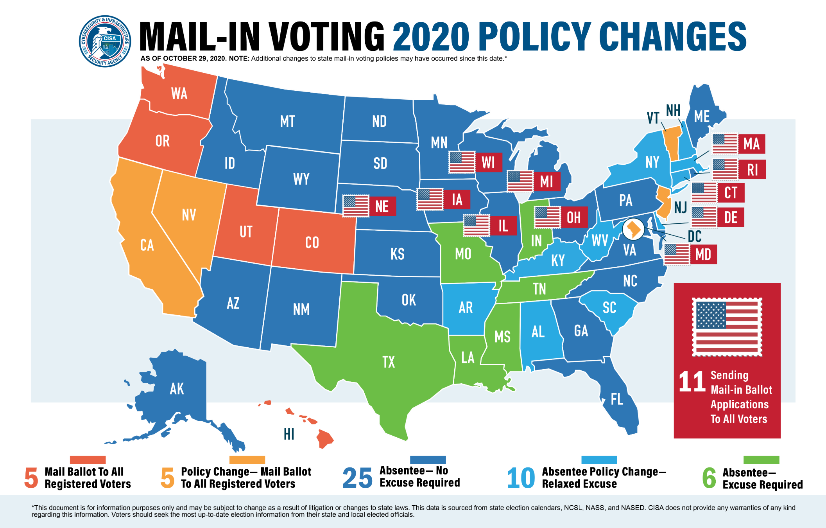
Just 3 Days Before the Election It’s Even Worse
Ron Benvenisti

Slide 18
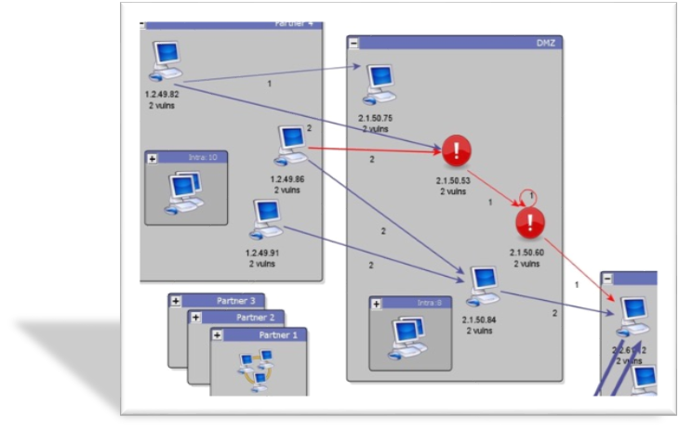
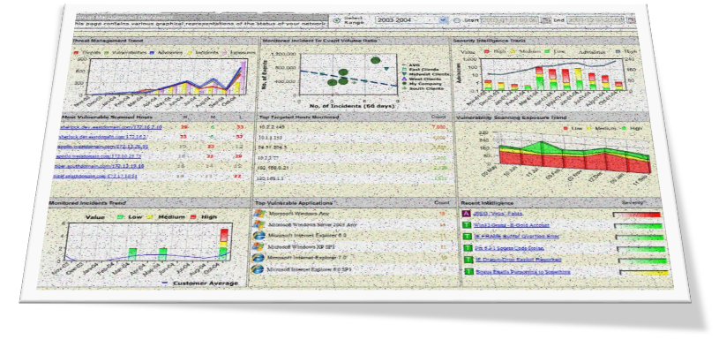
Put in Context, Prioritize it, Take Action Now???
Can you find the Vulnerability?
Visually Identify threats
Prioritize Mitigation
Strengthen Posture
Dashboards Display Several Security Tool “Windows” on one Screen
???
Data is displayed without proper context; no prioritization to mitigate security threats
You really need a Live, Interactive Common Operating Picture
Ron Benvenisti

Slide 19
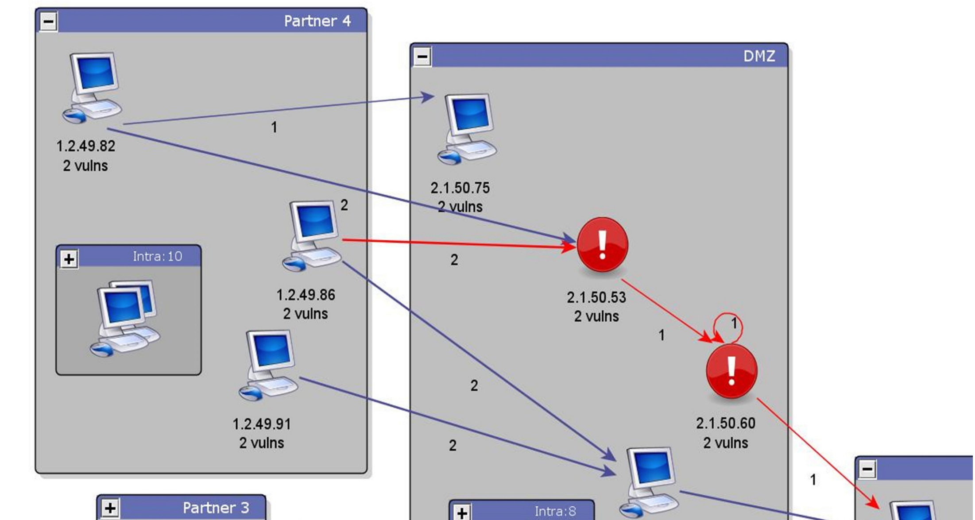
Take Immediate Action
Can you find the Vulnerability?
Visually Identify threats
Prioritize Mitigation
Strengthen Posture
Can you find the Vulnerability?
Visually Identify threats
Prioritize Mitigation
Strengthen Posture
Can you find the Vulnerability?
Visually Identify threats
Prioritize Mitigation
Strengthen Posture
Can you find the Vulnerability?
Visually Identify threats
Prioritize Mitigation
Strengthen Posture
???
Data is displayed without proper context; no prioritization to mitigate security threats
Ron Benvenisti

Slide 20
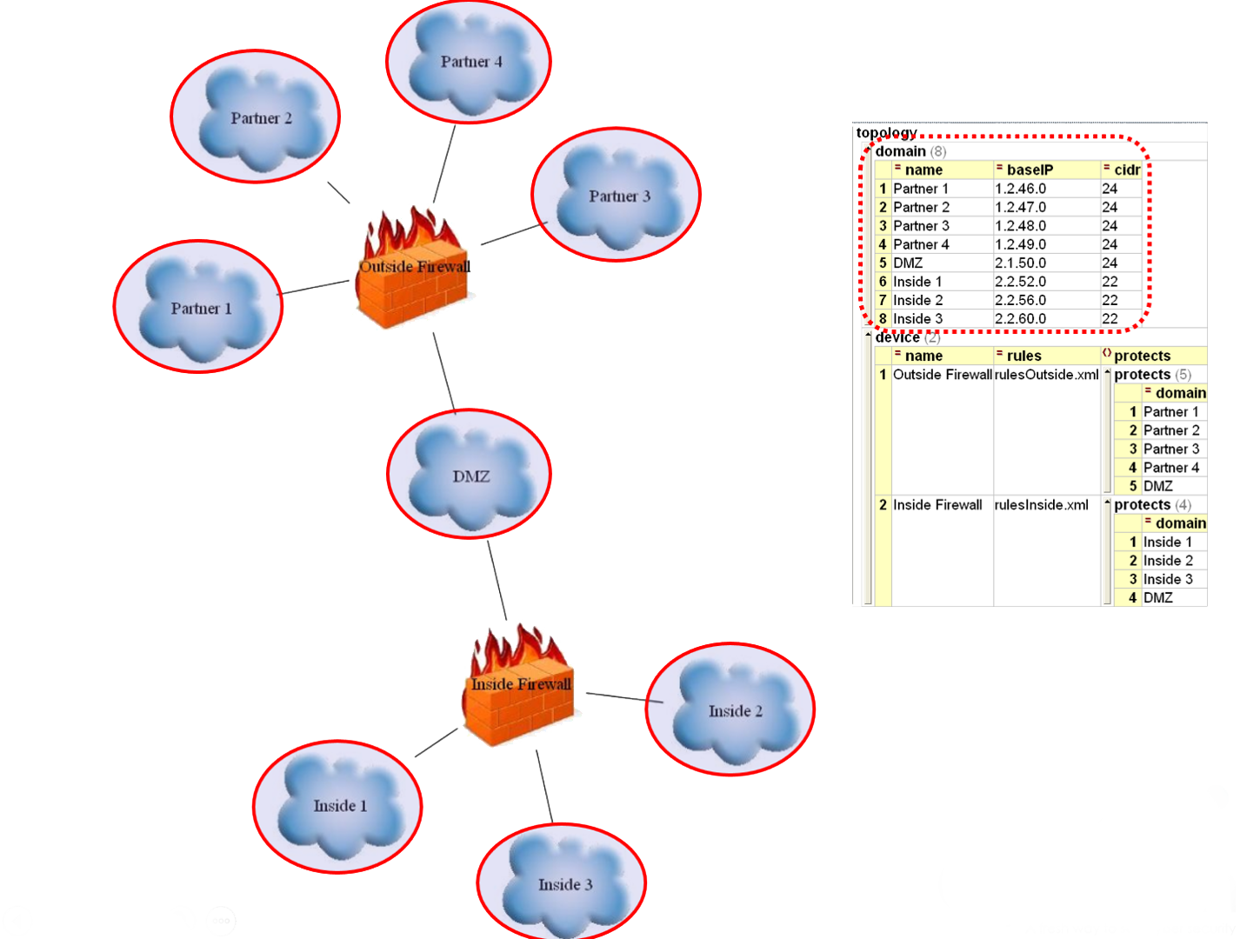
Zoom in and Drill Down
Monitor
Report
Remediate
RealTime
Ron Benvenisti

Slide 21
Have The Necessary Technology
Integrate and analyze three (3) types of cyber security data, common to all networks
Capable of analyzing data from a network of any size
An open architecture that can process data from a wide spectrum of sources
Algorithms that generate a “near real-time” view of an overall security profile
ACL Data
Log Data
Scan Data
Visual Threat Picture
Ron Benvenisti

Slide 22
Know Your Topology
Ron Benvenisti

Slide 23
Identify All Your Critical Assets
Healthcare Scenario
Ron Benvenisti

Slide 24
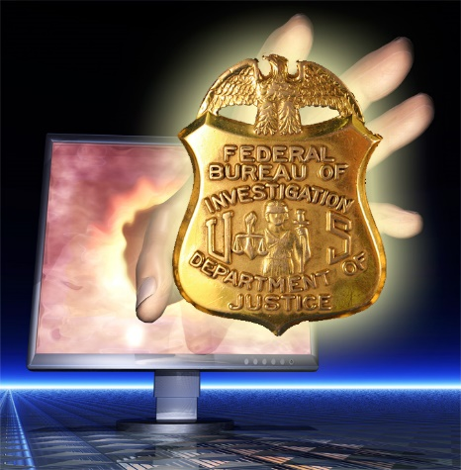
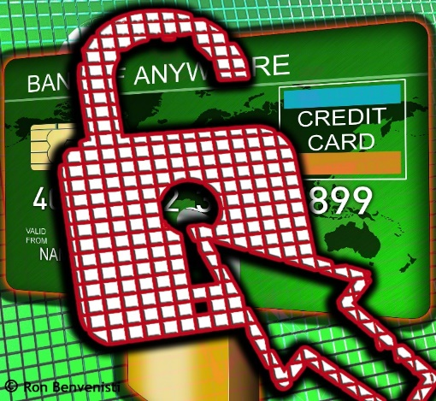
Know the Non-Compliance Risks
Fines, Criminal and Civil Liabilities,
Business Continuity, Reputation, Monitoring
Ron Benvenisti

Slide 25
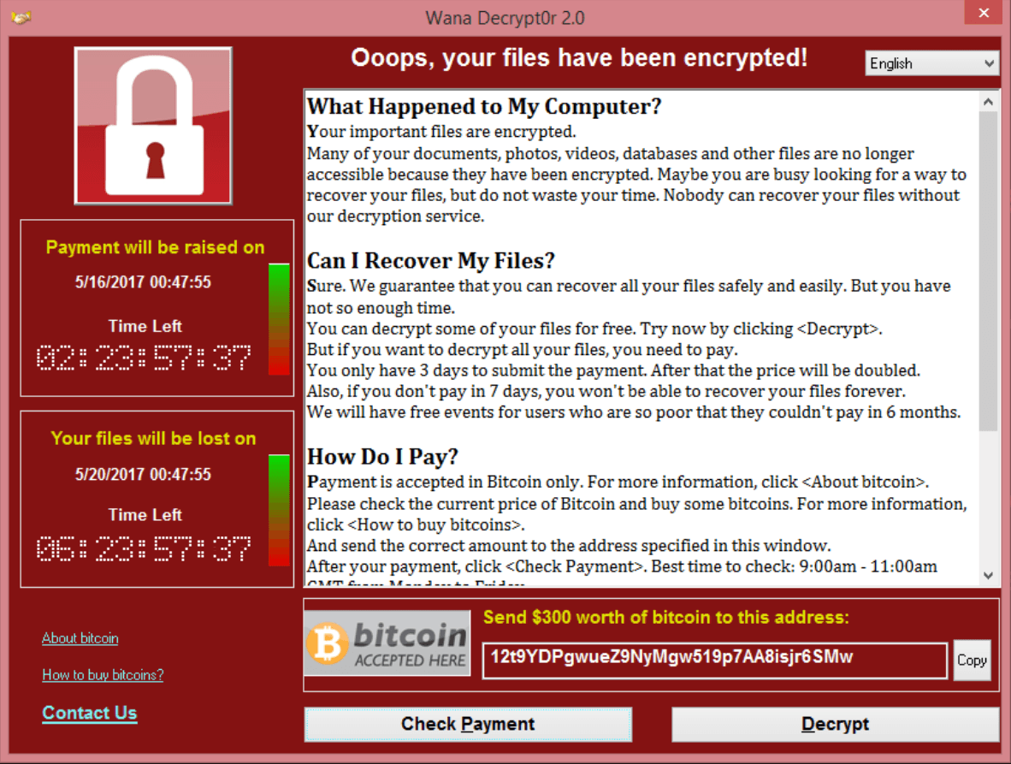
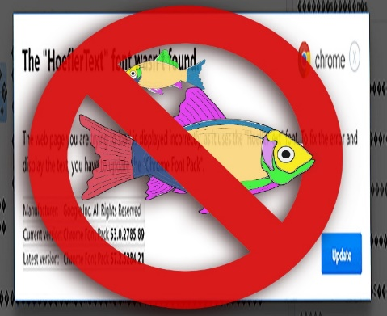
Fix the Non-Compliance Risks
Ron Benvenisti

Slide 26
Hurnan Resources/Social Engineering
It’s a People Problern
Ron Benvenisti

Slide 27
Hurnan Resources/Social Engineering
It’s a People Problern
Ron Benvenisti

Slide 28
Hurnan Resources/Social Engineering
It’s a People Problern
Ron Benvenisti

Slide 29
Put the Puzzle Together
Aggregate the Scan Logs’ Data
Ron Benvenisti

Slide 30
Achieve Defense In Depth
Compliance with NIST Special Publication (SP) 800 regulations, went into effect on Dec. 31, 2017
And are constantly updated as vulnerabilities evolve to address particular assets and sectors.
Security Information and Event Management
(SIEM)
Ron Benvenisti

Slide 31
Address Your Expanding Landscape
Volume
Scan Data
LAN/WAN (Mobile)
Cloud
ICS-SCADA
ACL Data
IoT
Logs
Platform
Complexity
Ron Benvenisti

Slide 32
The Addressable Market
Everything starts with an assessment
Planning
Remediation
Budgeting
Deployment
Everyone needs an assessment
Truly a horizontal market
Manual labor intensive
Commodity
Large or small – Assessments may be the best “entry point” to a new customer
Ron Benvenisti

Slide 33
Cybersecurity Offerings
Key Issues
In-house or Outsource
Total Cost of Ownership
Implementation time
Training time
New headcount required
Accuracy
SOC
MSSP
SIEM & Log management
Operations
Remediation Services
Revenue
Security Program Assessment
Traditional Vulnerability Assessments
Tend to be single data source – incomplete
Time consuming
Inaccurate
Silo’d
Not a Common Operating Picture
Wireless Assessment
Web App Assessment
Penetration Testing
Analytics
Vulnerability Assessment
Dark Web searches
Sales Cycle
Ron Benvenisti

Slide 34
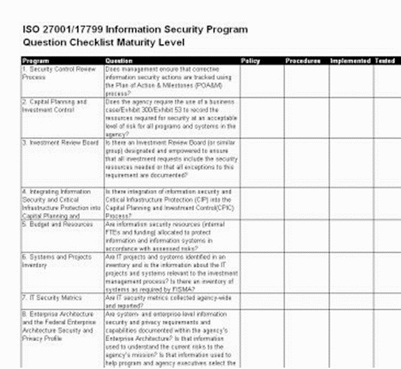
Will they Vet the Methodology?
Ron Benvenisti

Slide 35
The Cybersecurity Cyber Poverty Line
99% of US companies fall below the Cybersecurity Poverty Line.
They just don’t have the expertise or resources to protect themselves
and they are constantly being violated by malicious actors.
85% of businesses with < 1000 employees have been hacked,
and most don’t even know.
Ron Benvenisti

Slide 36
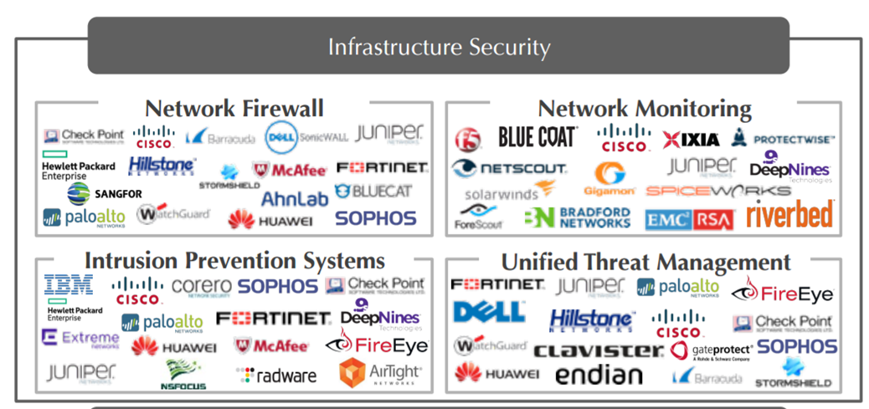
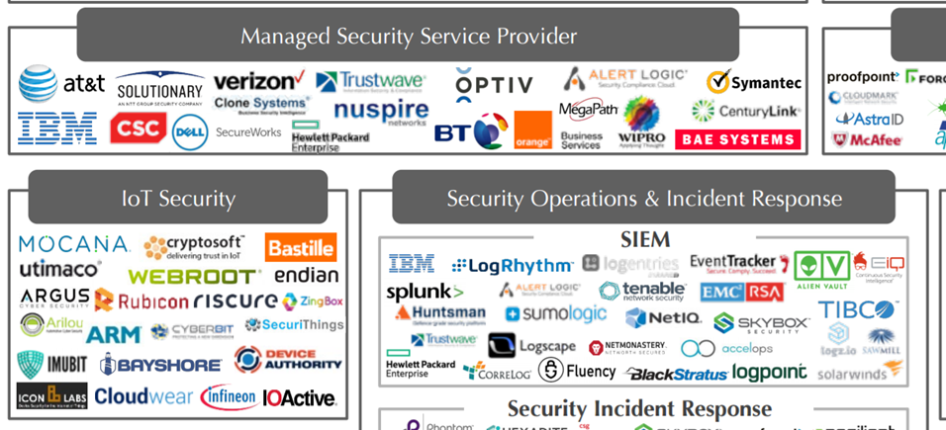
Market Landscape
Ron Benvenisti

Slide 37
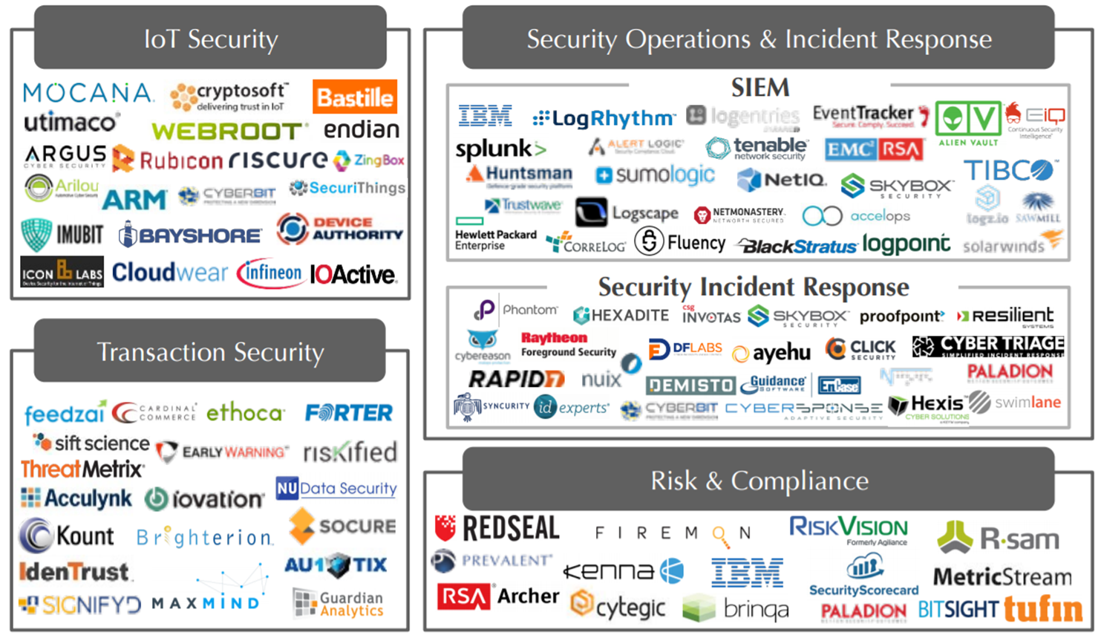
Landscape Verticals
Ron Benvenisti

Slide 38
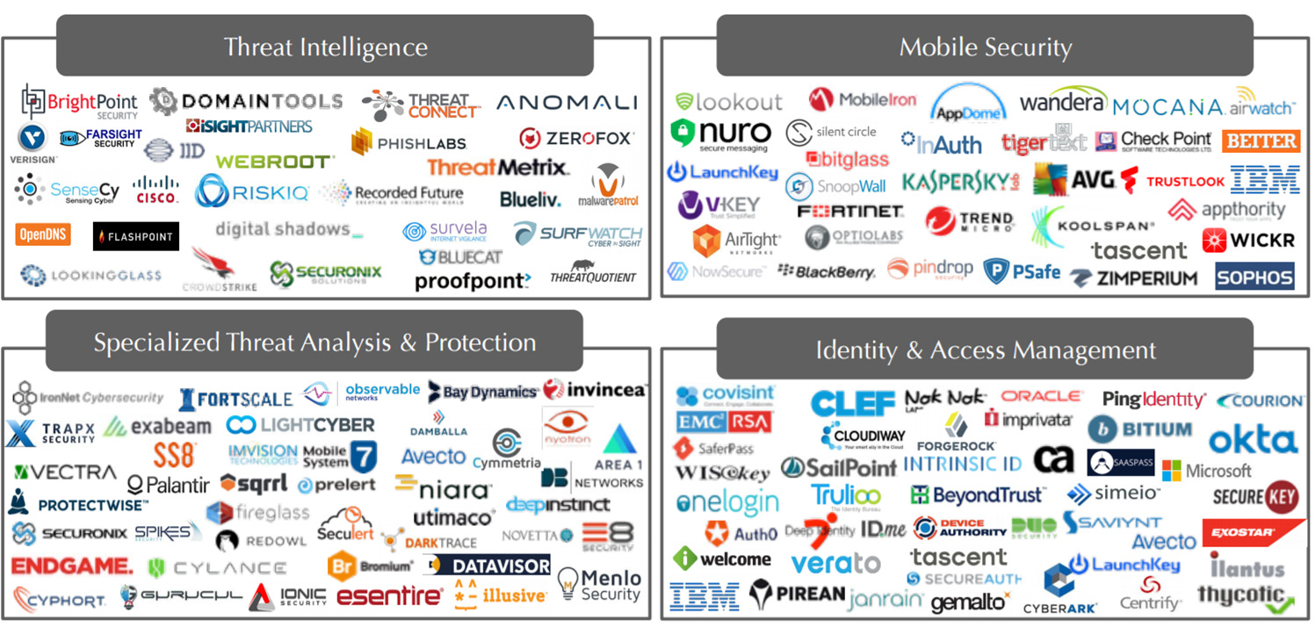
More Landscape Verticals
Ron Benvenisti

Slide 39
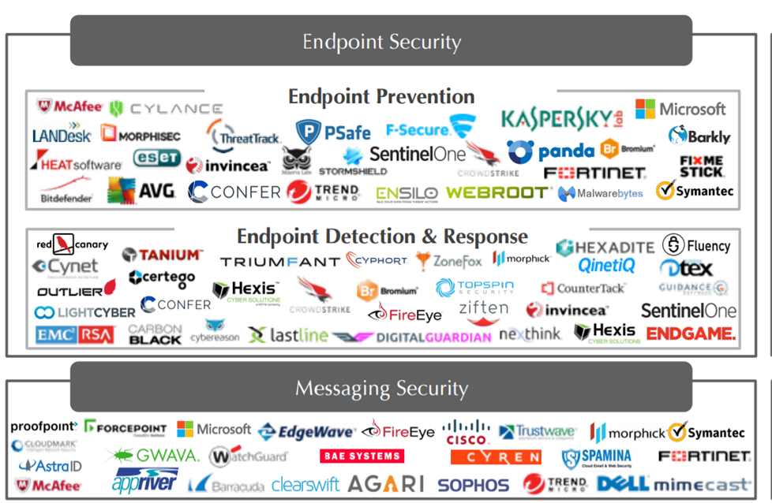
Yet Even More Landscape Verticals
Ron Benvenisti

Slide 40
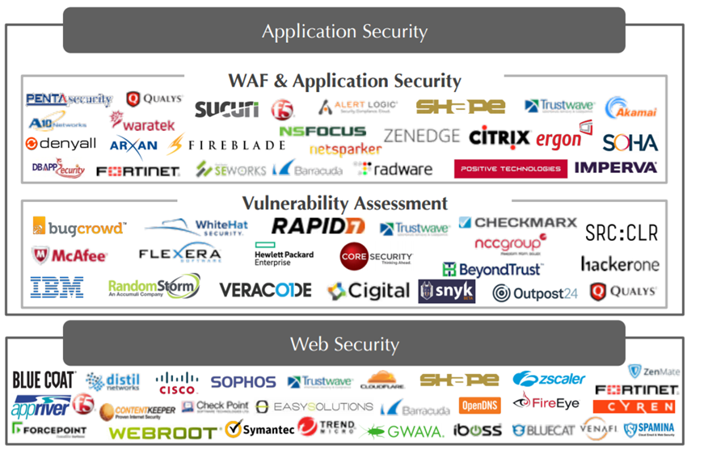
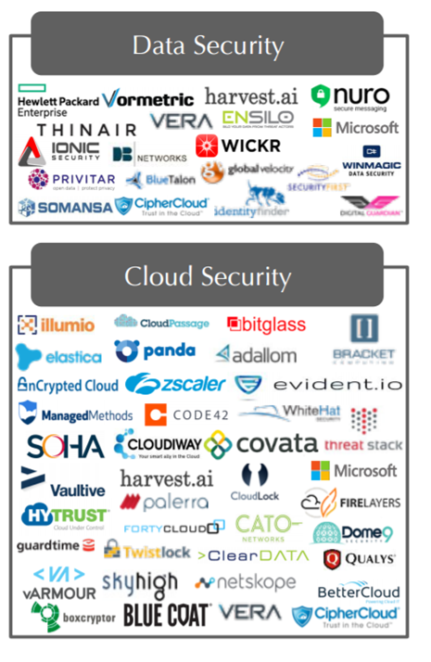
Enough Landscape Verticals?
Ron Benvenisti

Slide 41
Not Quite
Ron Benvenisti

Slide 42
What You Need to See First: The Network Scan
Ron Benvenisti

Slide 43
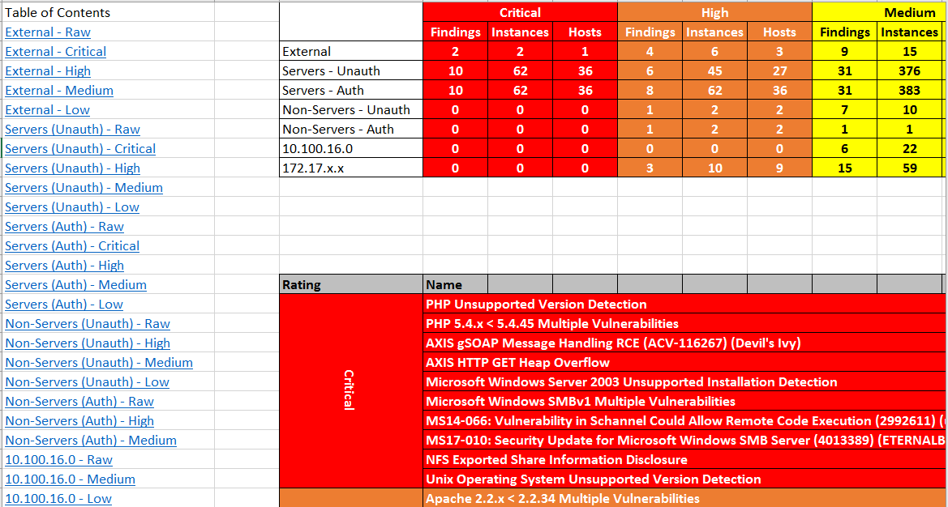
Do the Results Present a Prioritized Plan of Action?
Ron Benvenisti

Slide 44
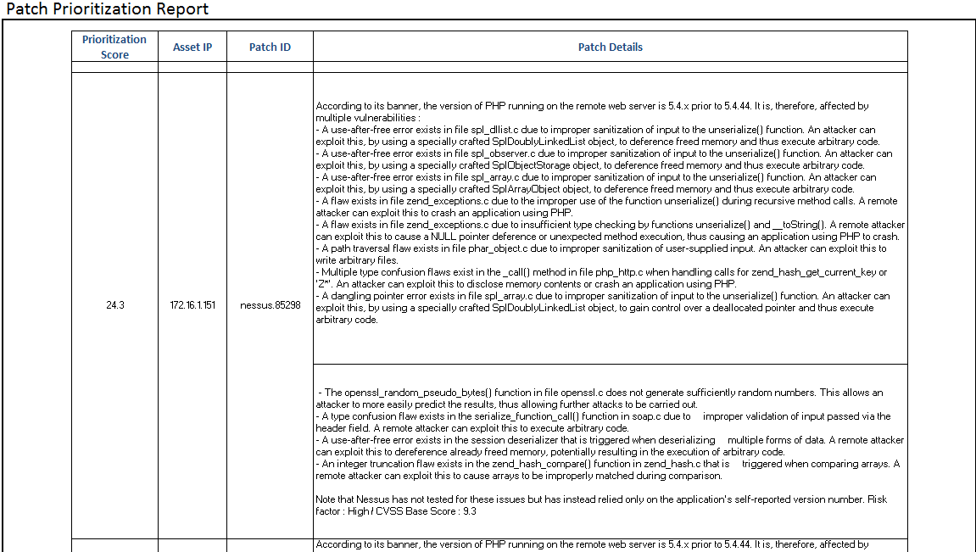
An Accurate Immediately Actionable Plan
Ron Benvenisti

Slide 45
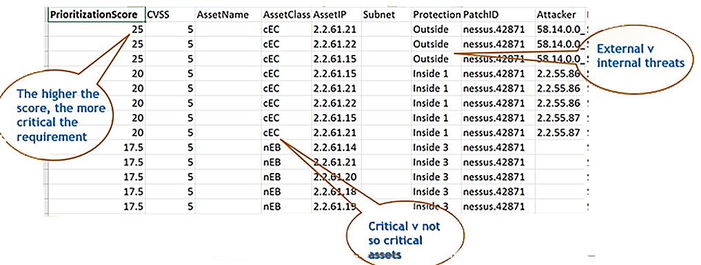
An Accurate Immediately Actionable Plan
Ron Benvenisti

Slide 46
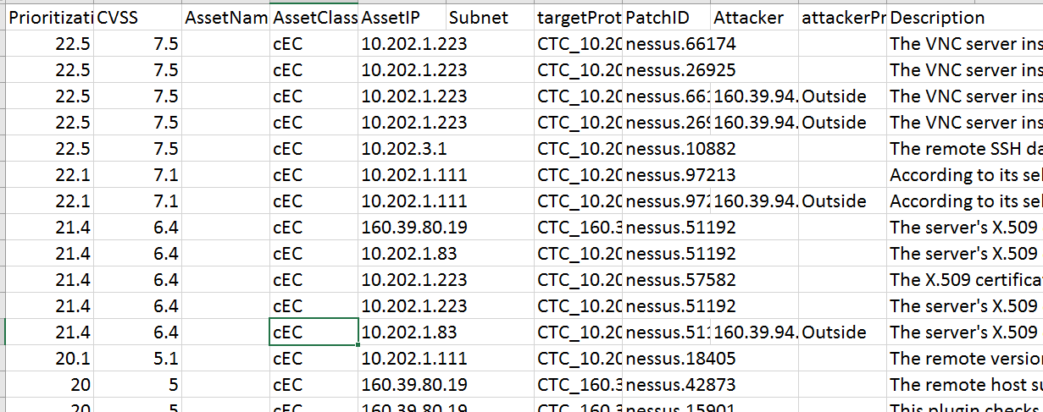
Immediately Actionable Plan for IT Managers to Implement ASAP
“WE NEED TO FIX THIS”
“I’m on it.”
Ron Benvenisti

Slide 47
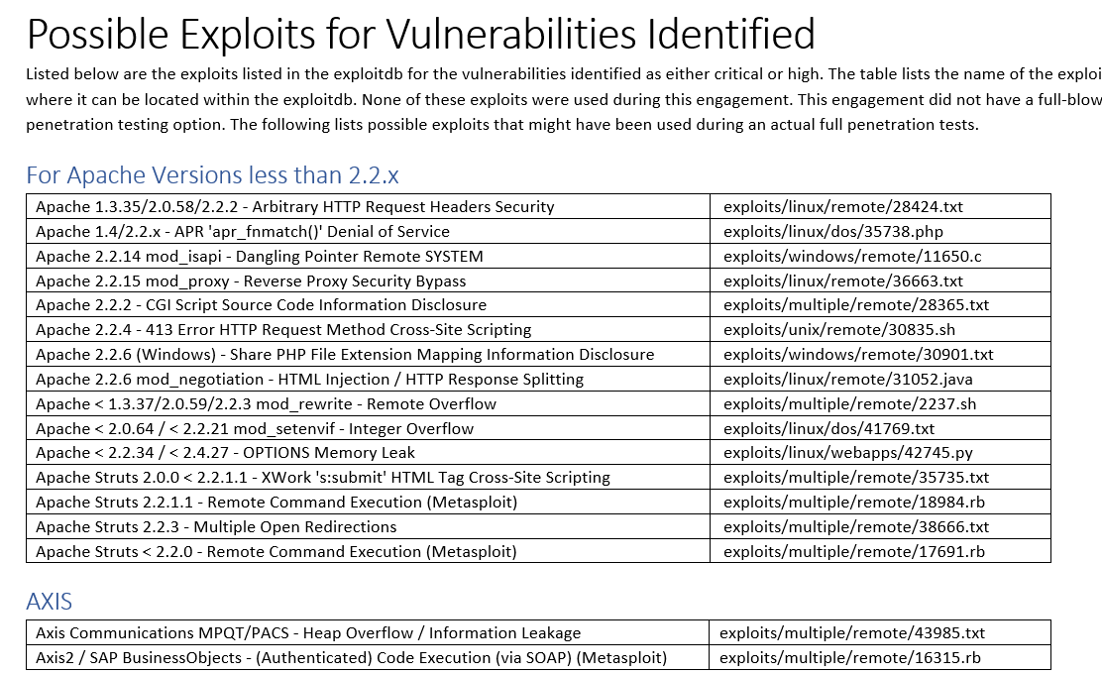
Immediately Actionable Plan for IT STAFF to Implement ASAP
“Hey you! WE NEED TO FIX THIS NOW.”
“Piece of cake.”
Ron Benvenisti

Slide 48
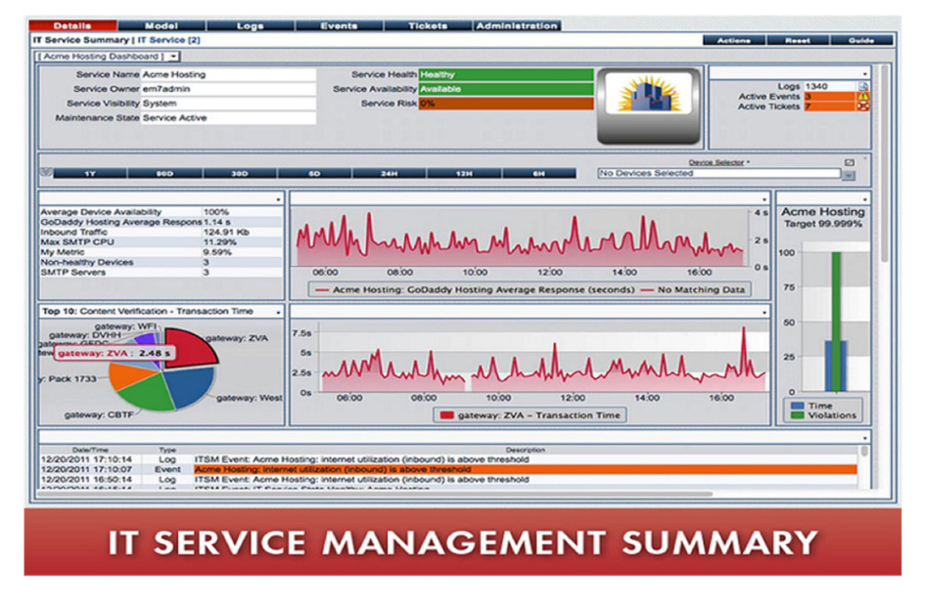
Or a Confusing Screen of Windows for IT Management and Staff to Decipher?
Ron Benvenisti

Slide 49
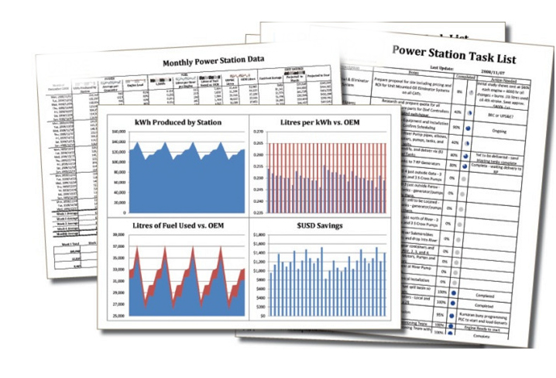
In Cybersecurity, There’s No Time to Rely on Traditional Reporting
Ron Benvenisti

Slide 50
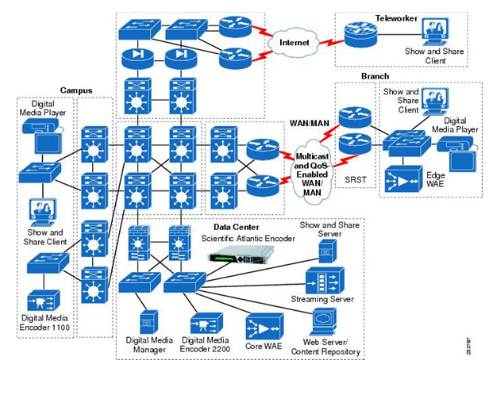
Do You Know Who I Am?
Ron Benvenisti

Slide 51
I Have Friends in High Places
Ron Benvenisti

Slide 52
You Have Connections!
Can you find the Vulnerability?
Visually Identify threats
Prioritize Mitigation
Strengthen Posture
Ron Benvenisti

Slide 53
Are They Team Players or Rockstars?
Can you find the Vulnerability?
Visually Identify threats
Prioritize Mitigation
Strengthen Posture
Dashboards Display Several Security Tool “Windows” on one Screen
???
Data is displayed without proper context; no prioritization to mitigate security threats
You really need a Live, Interactive Common Operating Picture
Ron Benvenisti

Slide 54
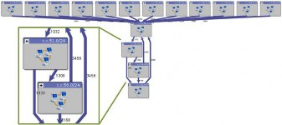
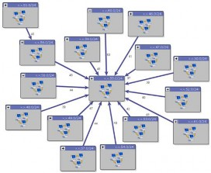
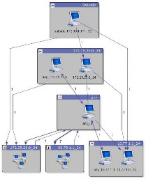
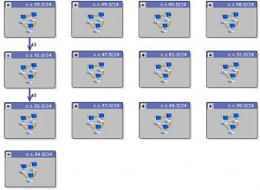
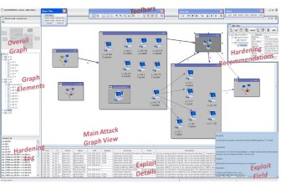
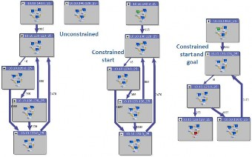
Click to Auto-Map, High Level View, Deep Dive
Ron Benvenisti

Slide 55
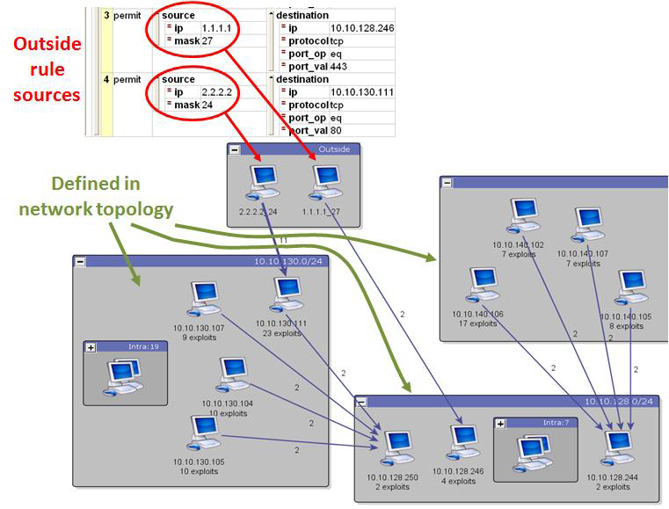
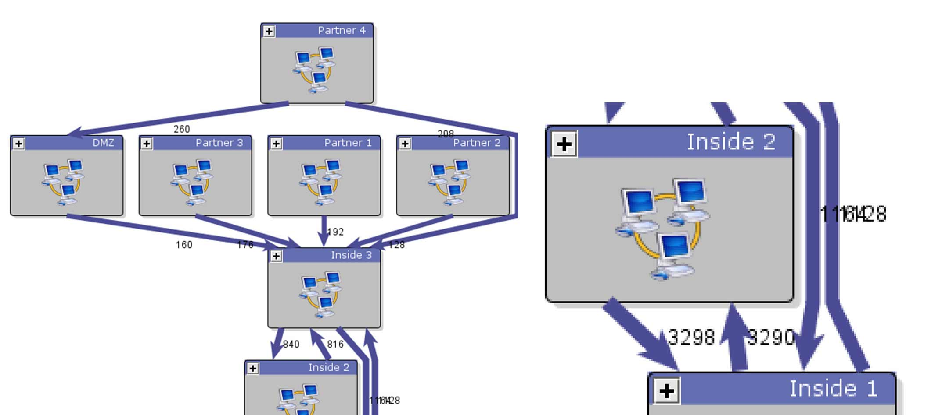
Elapsed Time Average = 28 seconds
4
1
2
3
Ron Benvenisti

Slide 56
You’ve Got a lOT of New Friends or Foes
Ron Benvenisti

Slide 57
Cybersecurity Essentials for 2021
Thank you for watching,
Ron
© 2020 Ron Benvenisti ron@benvenisti.net 917-709-1228
FEMA Certified - NIST Zero Day Counter Terrorism Licensed
Patented DHS Project Cauldron™ SaaS Cybersecurity Assessment, Remediation and Management SME
GSA Listed – DOD MURI ID – Ocean County Committee Rep. District 4 – Lakewood District 26
Ron Benvenisti

